Slide 1




Presented by Rasel shikder
Lease Financing
Use Assets Without Owning Them!

Slide 2

What is Lease Financing?
A long-term rental where the lessee uses the asset while the lessor owns it, with regular payments instead of a full purchase, commonly used for 💻 IT equipment, 🚗 vehicles, and 🏢 property.

Slide 3







Types of Leases
Operating Lease
Short-term use, easy to cancel, no ownership risk.
Financial Lease
Long-term, lessee bears risks, can gain ownership.
Leveraged Lease
Involves third-party financing for large assets.

Slide 4



Who’s Involved?
Lessor
The legal owner of the asset who leases it out to earn income.
Agreement
A contract that specifies payment terms, lease duration, rights, and responsibilities of both parties.
Lessee
The user of the asset who pays periodic rent for using it.

Slide 5
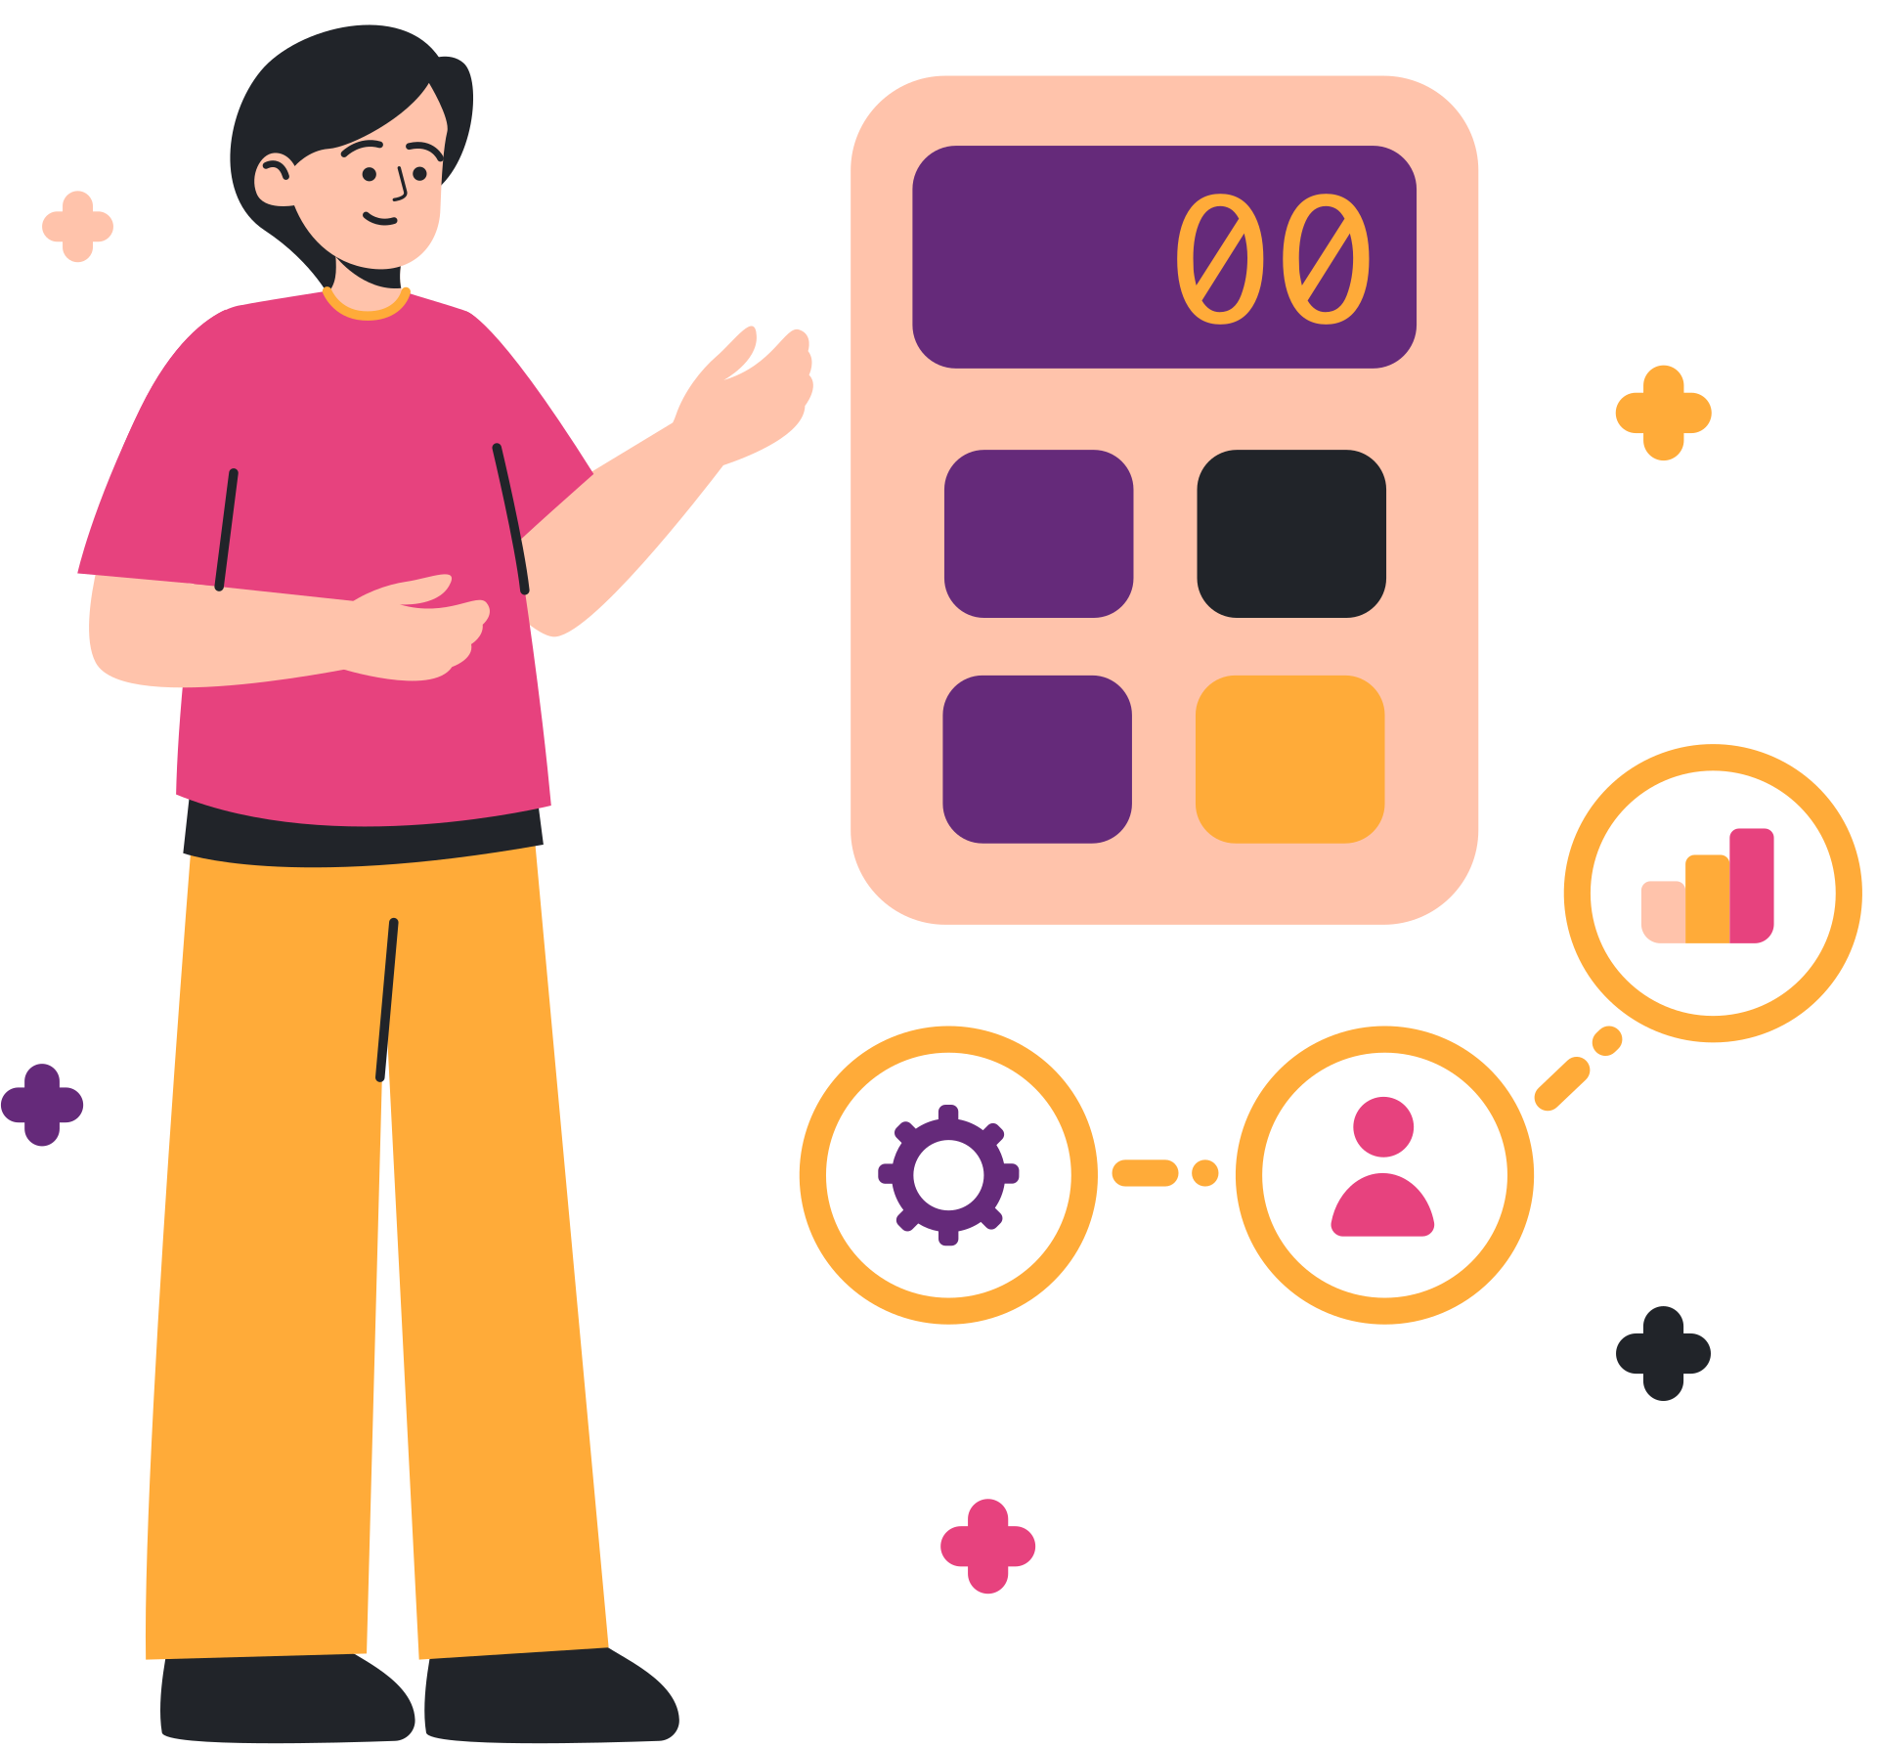
Key Features
🔑 No Ownership Transfer
Ownership stays with the lessor.
💸 Fixed Monthly Payments
Regular and predictable payment schedule.
📅 Lease Period Set in Advance
Start and end date agreed upfront.
🏢 Covers Expensive Assets
Ideal for property, vehicles, and machinery.
🧾 Tax-Deductible for Lessee
Payments can reduce taxable income.

Slide 6

Benefits You’ll Love!
💰 Low Initial Cost
Keeps more cash available for your business.
⚙️ Easy Access to Modern Assets
Upgrade to the latest equipment quickly.
🛠 low Maintenance Hassle
Upkeep is usually handled by the lessor.
📜 Flexible Terms
Choose the lease period and conditions that fit.
🧾 Tax Benefits
Lease payments can lower taxable income.
🏦 Preserves Borrowing Capacity
Doesn’t tie up credit lines like loans do.

Slide 7
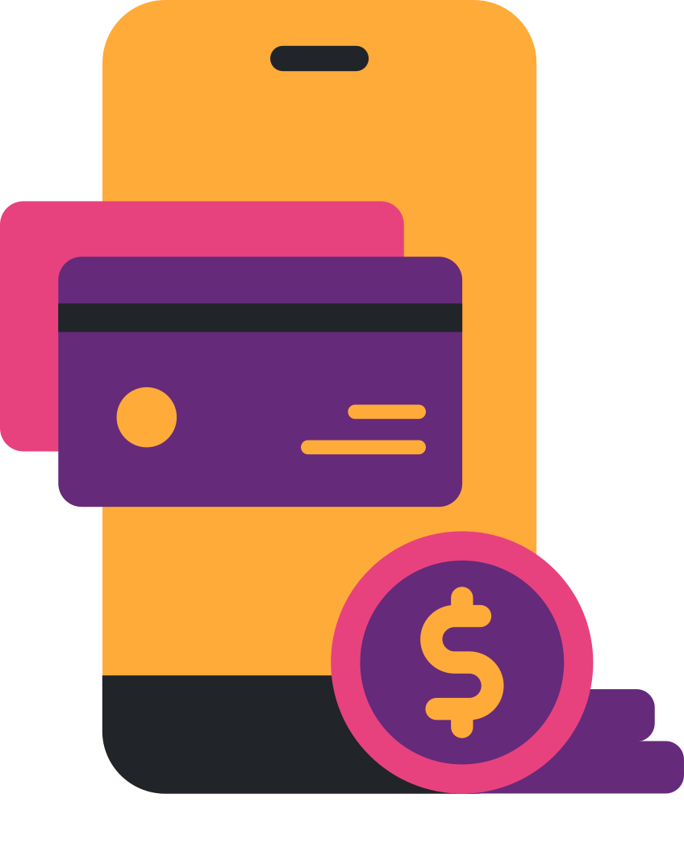
Drawbacks!
⚠️ You Don’t Own It
⚠️ Long-Term Costs Can Add Up
⚠️ Restrictions on Usage or Exit
⚠️ Might Be Locked Into a Bad Deal

Slide 8

Lease vs Buy
Factors | Lease | Buy It
Cost Now | Lower upfront cost | Higher upfront investment
Ownership | No ownership | Full ownership
Flexibility | High (easy to upgrade/return) | Low (asset tied up)
Best For | Short/medium-term use | Long-term asset use

Slide 9



Mission and Vision
Vision
To be the leading provider of innovative lease financing, empowering growth and sustainability for organizations worldwide
Mission
To provide businesses and individuals with flexible, cost-effective leasing solutions, helping them access modern assets without heavy upfront investments.

Slide 10

Final Thoughts
Key Takeaways
Leasing means using, not owning. It helps businesses manage cash flow, access modern assets, and stay flexible with tax benefits, but always understand the risks before signing.

Slide 11

Thank You
For listening!

